Slide 1
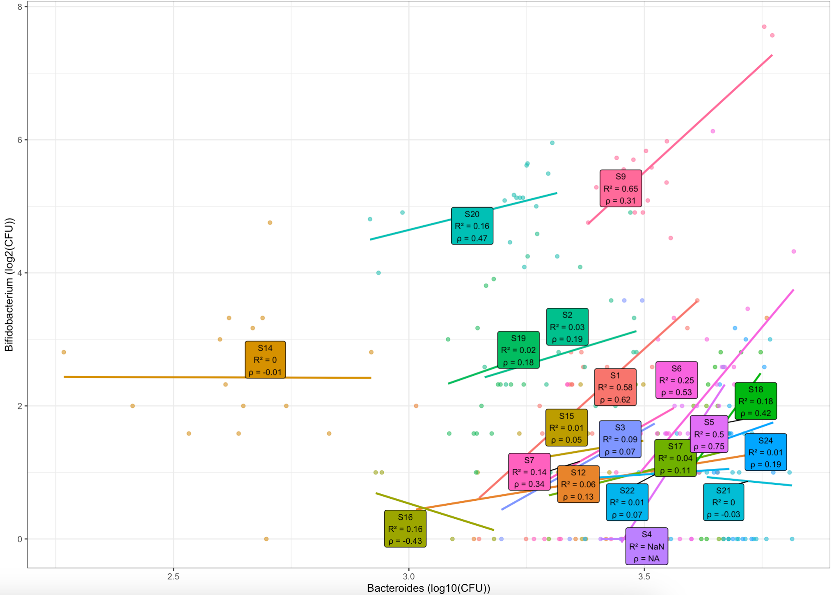

Slide 2
S20
S19
S22
Notes:
Across Microbiomes, Rumoinococcus, [Eubacterium] eligens, Fusicatenibacter, and Lachnospiraceae NK4A136 response similarly to pericarp treatments, suggesting potential cross-feeding or cooperative relationships within the group. [Eubcacterium] xylanophilum shows a different response to pericarp compared to the group, indicating different pericarp utilizing pathways exist. PHG47 is most microbiome responsible pericarp treatment, followed by HP301, (and NC262).

Slide 3
S6
S9
S12
S19

Slide 5
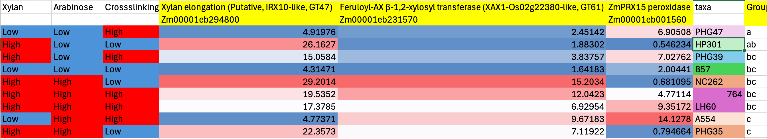

Slide 6
Plans for the next step
Heatmap for Bifidobacterium, Bacteroides, Runimococcus, [Eubacterium] eligens, Fusicatenibacter, and Lachnospiraceae NK4A136 in S6, S9
Grow Bifidobacterium, Bacteroides, Runimococcus, [Eubacterium] eligens, Fusicatenibacter, and Lachnospiraceae NK4A136 in PHG47 and LH60 (in S9) and do the transcripnomic test to check the gene expression differences.

Slide 7
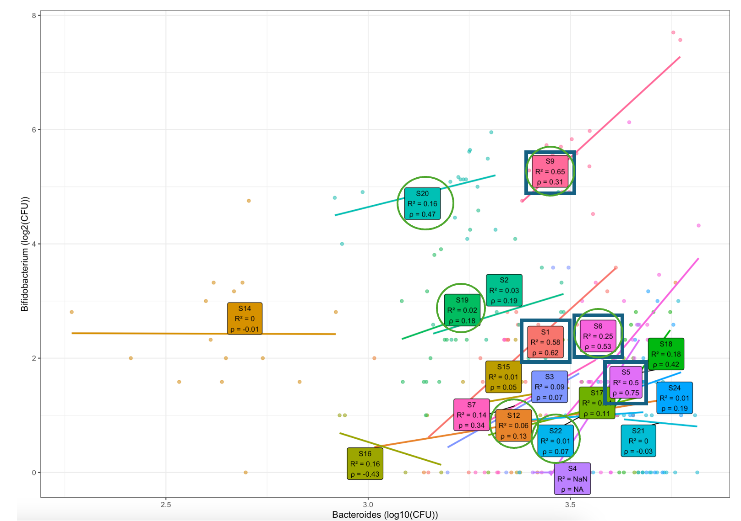
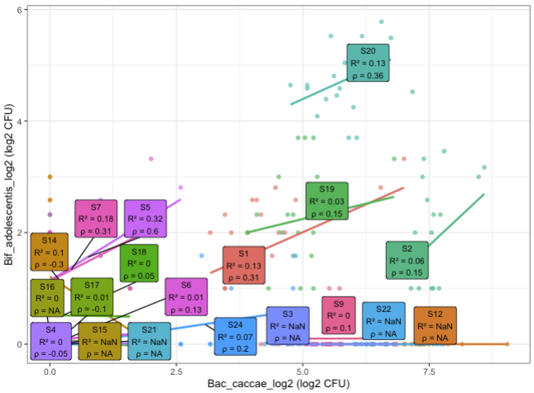
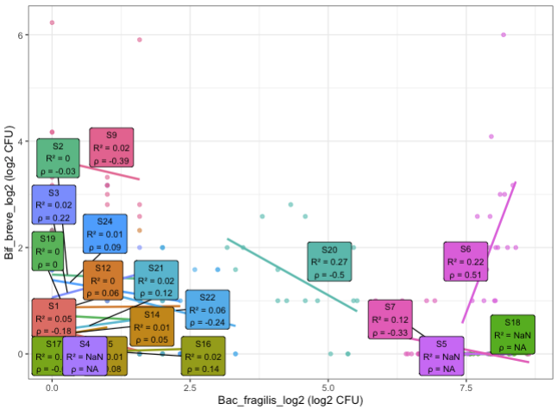
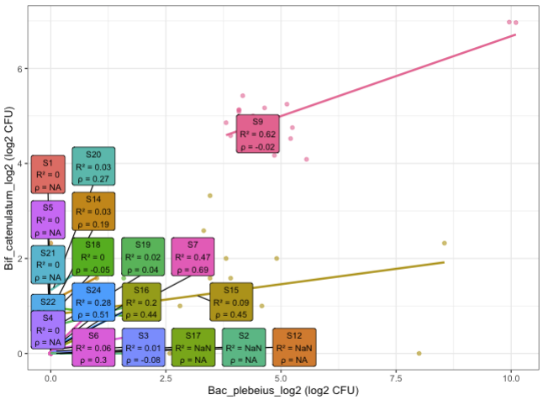
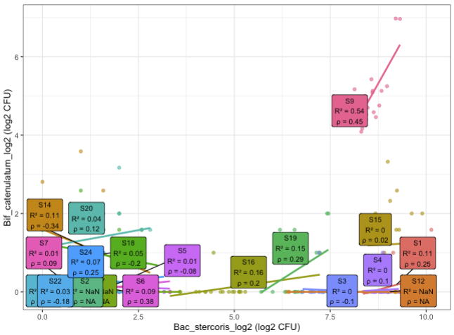
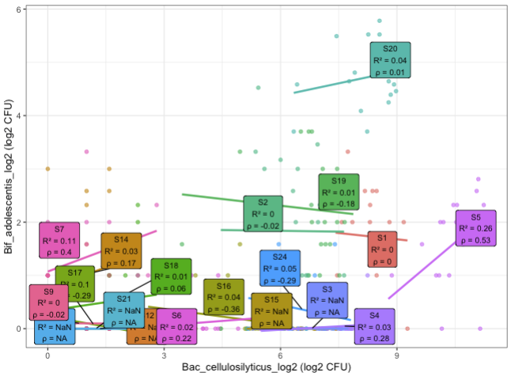
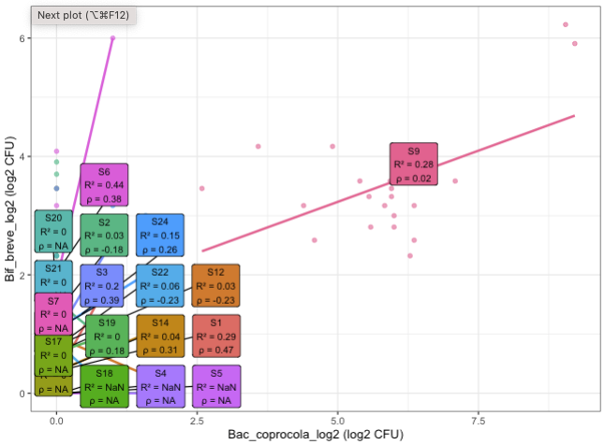
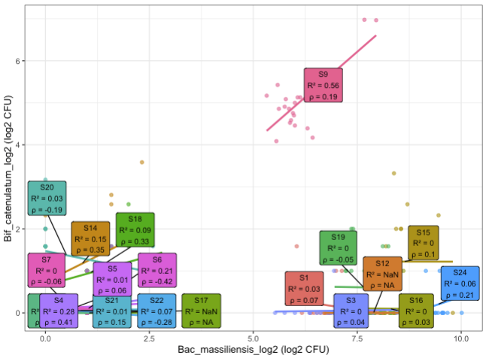
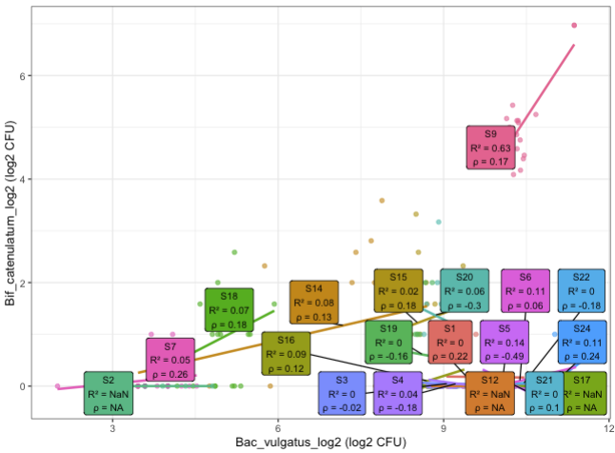
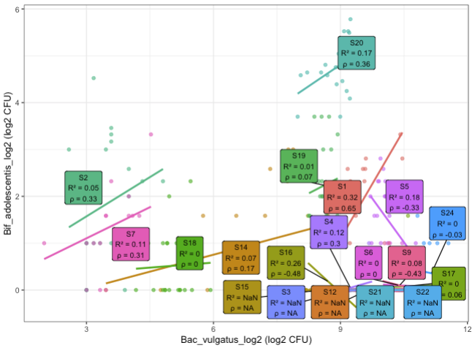
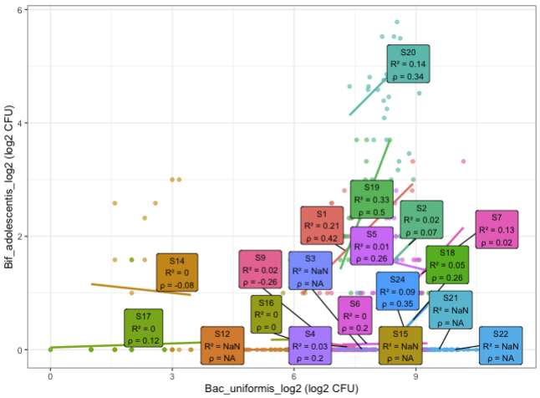
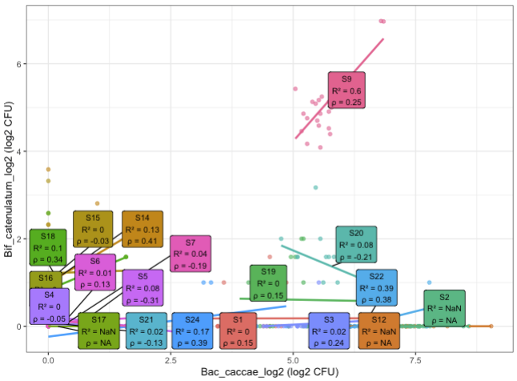
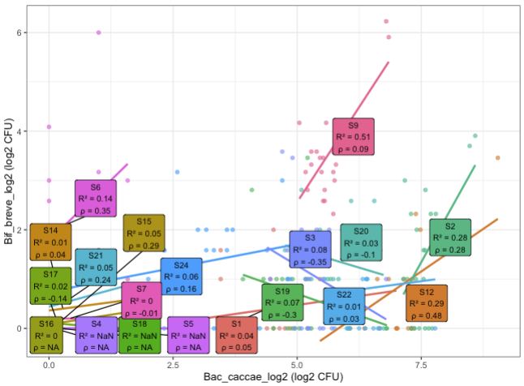
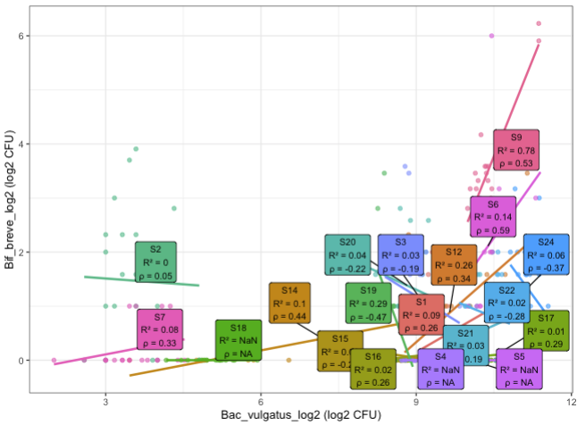
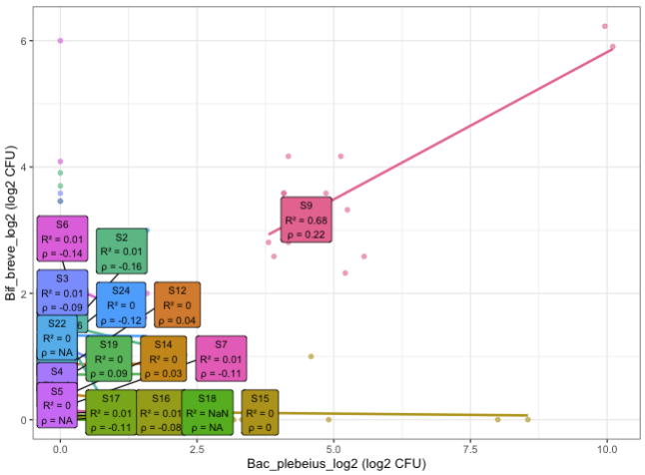
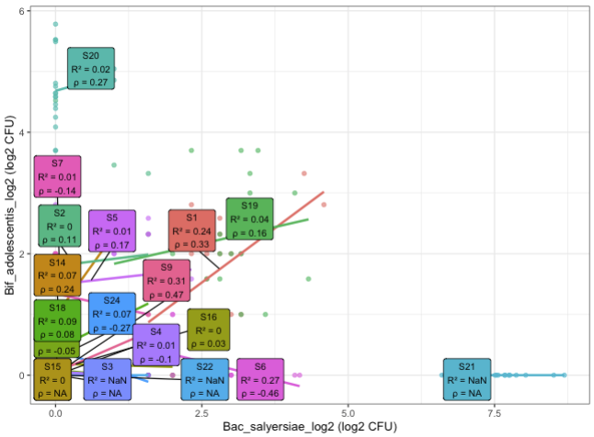
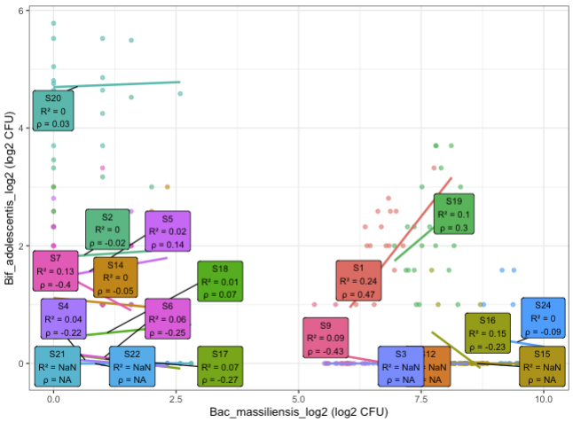
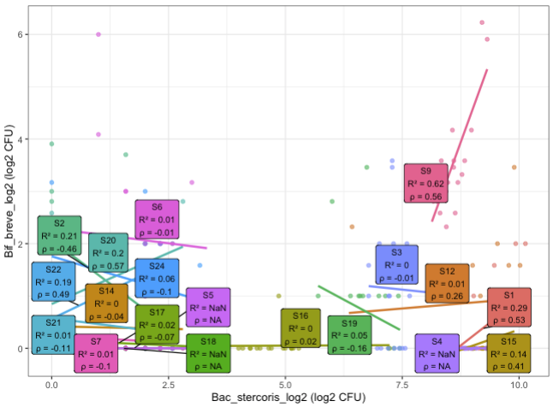
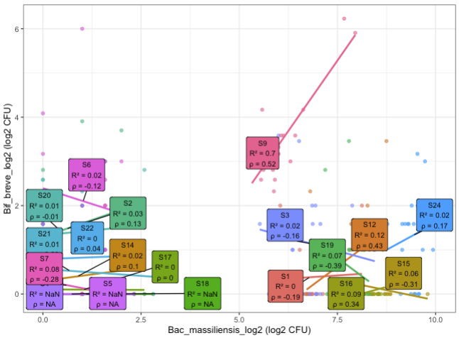

In S1, S5, S6, S9, Bifidobacterium and Bacteroides have strong association

Slide 8
S6
S9

Slide 9
S6
S9
S12

Slide 10
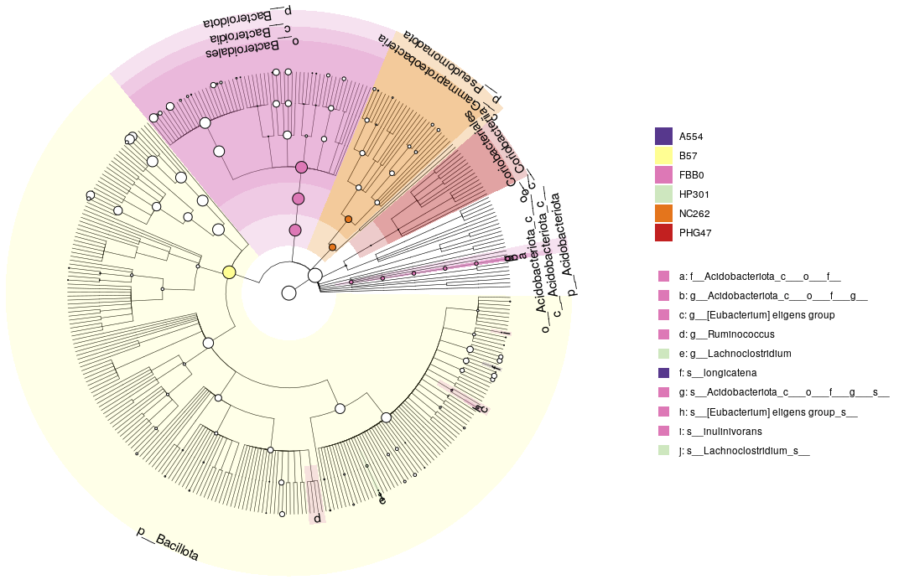
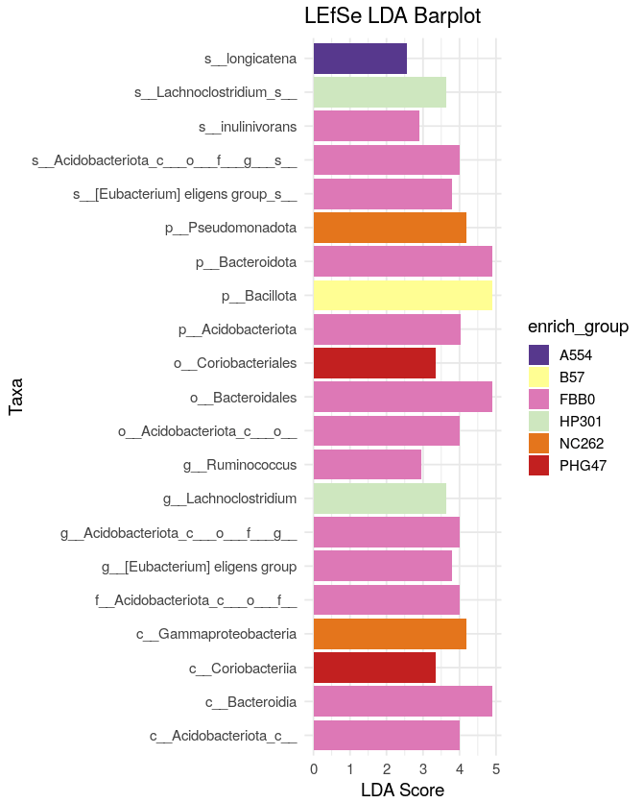
S6 S9 S12

Slide 11
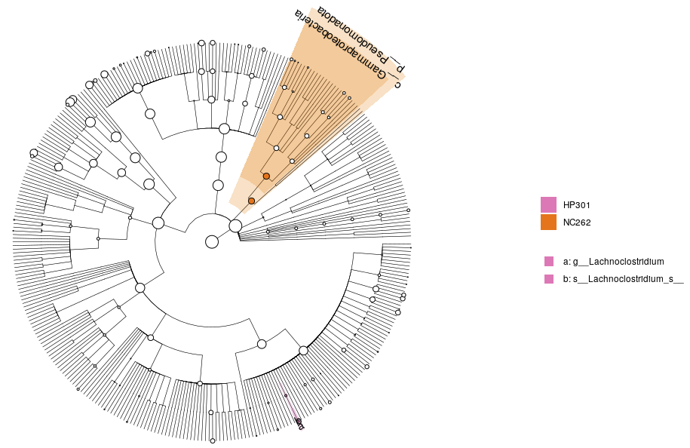
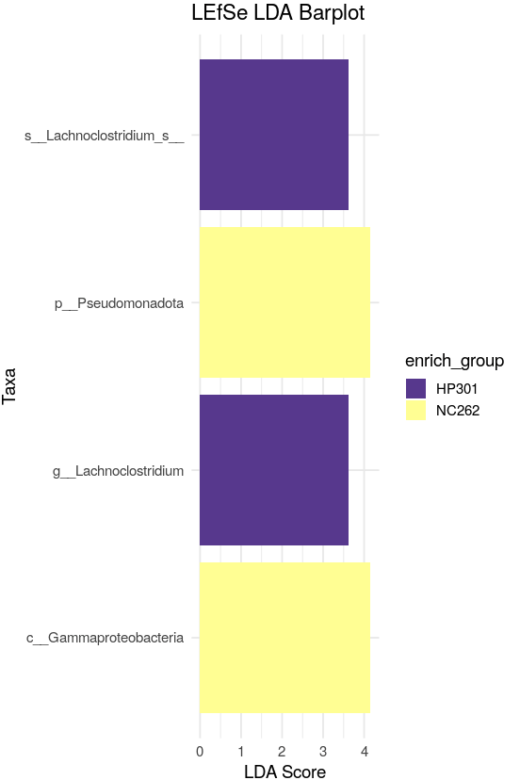
S6 S9 S12 without FBB0

Slide 12
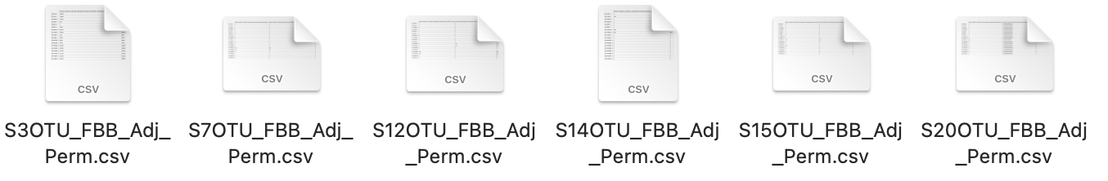

Slide 13
S1
S9

Slide 14
S1 S9, B.long, B.adu,
PHG47 HP301 B57 NC262 A554
3 time points (24, 48, 72, passing)
3 tec reps
4 *5 *3 * 3= 180 (2 plates)

